Slide 1
Temple Rituals and Festival Scheduler
-by
R. Dharanasankareswari

Slide 2
Problem Statement
The traditional management of temple rituals and festivals is often manual and prone to errors, leading to inefficiencies in scheduling, participant coordination, and resource allocation.
This system aims to automate the scheduling, participant management, and notifications for rituals and festivals, ensuring a smooth, efficient, and error-free process for temple staff, priests, and visitors.

Slide 3
Introduction
The Temple Rituals and Festival Scheduler is a system designed to automate the scheduling and management of temple events. It helps in organizing rituals, festivals, and participant registrations efficiently. The system aims to streamline event notifications, reducing manual effort. This ensures smooth operations, timely communication, and an enhanced experience for both temple staff and devotees.

Slide 4
OOPs Concept Used
Classes and Objects:
Models real-world entities (Ritual, Festival, Temple) as objects to represent temple components with data like name, description, and date.
Encapsulation:
Keeps data private in Ritual and Festival classes, accessed only through getters, ensuring security and controlled data modification.
Polymorphism:
Overriding toString() allows customized output for Ritual and Festival objects without changing their core structure.
Abstraction:
Hides complex event scheduling logic inside the Temple class, providing a simpler interface for users.

Slide 5
DSA Concepts Used
ArrayList:
Stores dynamic collections of Ritual and Festival objects. It allows easy addition/removal and automatic resizing as events are scheduled.
Sorting:
Sorts Ritual and Festival lists by date to display events in chronological order, ensuring an organized schedule for users.

Slide 6
2) Class to represent a Ritual
1) Importing necessary classes for date formatting and working with lists

Slide 7
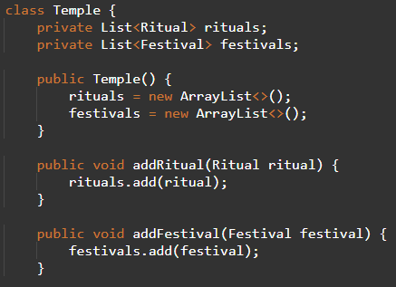
3) Class to represent a Festival
4) Class to represent the Temple

Slide 8
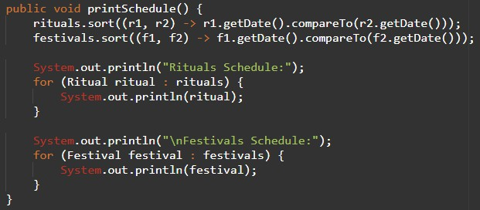
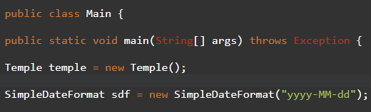
5) Sorting rituals and festivals by date
Main method Throw Exceptions Creating a Temple object Sample date formats

Slide 9
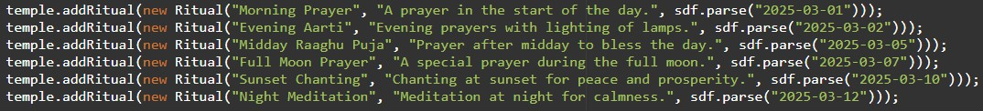
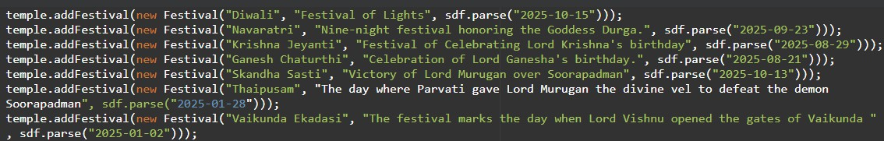

5) Adding Rituals
7) Adding Festivals
8) Printing the Result

Slide 10
Future Enhancements
Voice Command Features
Virtual Reality (VR) Integration for Ritual Visualization Enhanced Data Analytics for Festival & Ritual Optimization Real-Time Streaming of Rituals and Festivals:

Slide 11







Thank you

